Slide 1
Stopping Malicious Bots Others Don’t
The Veracity Protection Platform

Slide 2
Who We Are
& What We Do

Slide 3
Who We Are & What We Do
Our mission
Malicious bots are constantly evolving, and so are we. Our patent pending, machine-learning bot protection lives on your digital estate, analysing micro-behaviours, to identify and block threats in real-time. Put simply — we block what others don’t.
Global presence
We’re headquartered in the UK, with a subsidiary company in Singapore. We’re also highly active in the UK, Asia Pacific, and the GCC. With clients in the US & EU as well.
What we protect
Abbi (our machine-learning model) protects digital ads (Ad Fraud Prevention) and websites or web apps (Web Threat Protection) from sophisticated bots.
Why we’re different
We’re the only bot defence platform that sits Beyond the Edge to utilise real-time behavioural analysis to detect and block even the most complex bots.

Slide 4

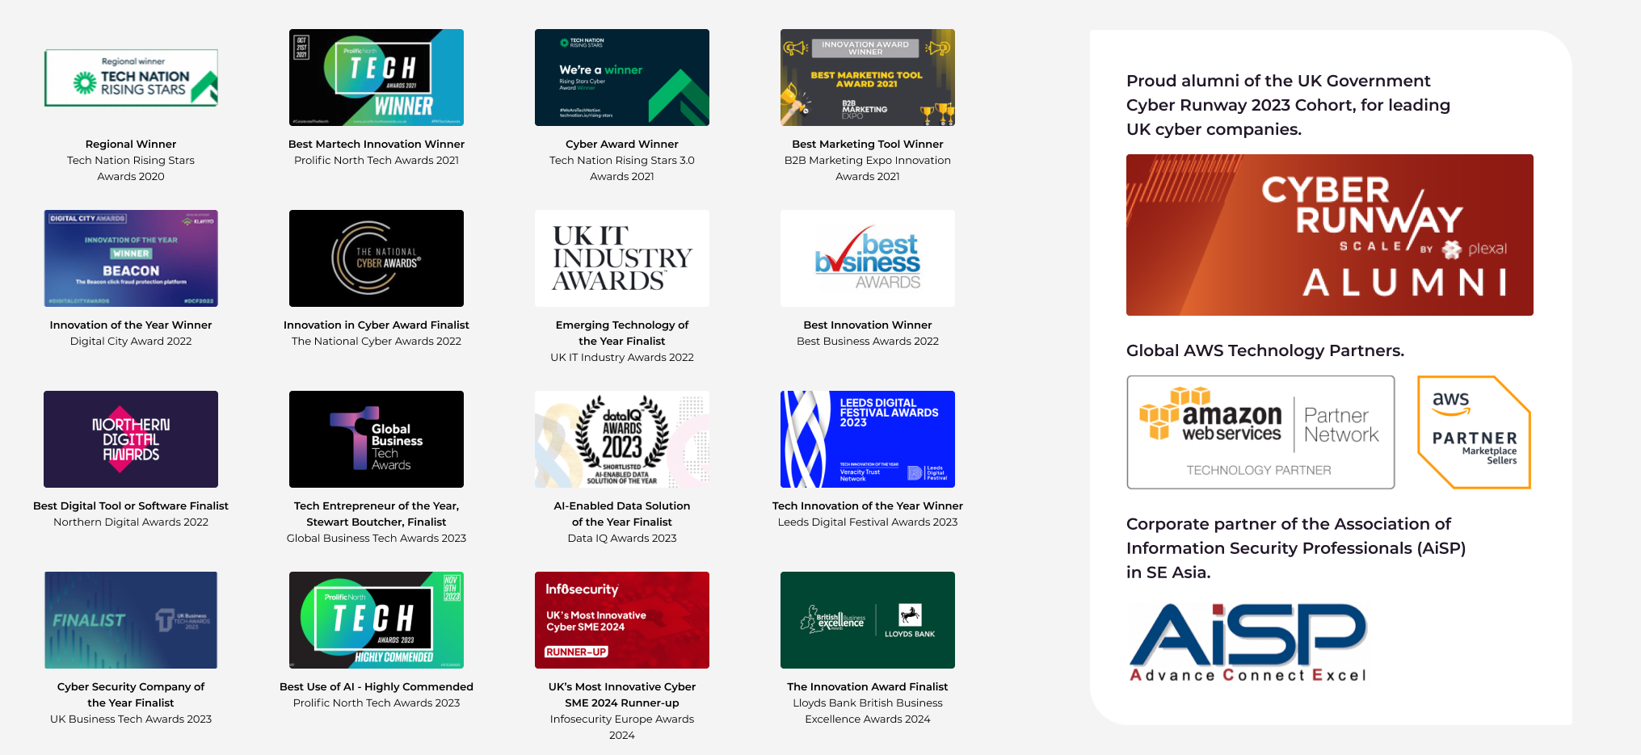
Award-winning protection
Highly commended
Technological Impact of the Year 2024
Notes:
Technological Impact of the Year

Slide 5
The Bot Problem

Slide 6
The scale of the problem
30%
of all traffic to websites is from sophisticated malicious bots
$4.45m
the global average cost of a data breach*
11%
of UK businesses and 8% of charities experienced cybercrime in the last 12 months**
~50%
Of consumers said they had stopped doing business with a company known to have experienced data loss through cybercrime***
*Ponemon Institute survey on behalf of IBM. **UK Cyber security breaches survey 2023. ***IBM Report — the Cost of Data Breaches

Slide 7


“
Detecting bots is difficult because the sophisticated ones try to appear human and evade detection. Your bot management solution must protect from every OWASP automated threat and be accurate in detecting the difference between human and bot traffic on your website, mobile apps, and APIs.

Slide 8


“
Part of the reason sophisticated bot attacks can be hard to stop is due to the complexity inherent in intelligent bots… reactive fraud solutions that rely on known patterns and historical data are fairly ineffective, because fraudsters use AI to evade detection and present signals meant to deceive most bot detection systems.
The Intelligent Bot Revolution: What Businesses Need To Know

Slide 9


“
User and entity behaviour analytics (UEBA) is a cybersecurity solution that uses algorithms and machine learning to detect anomalies in the behaviour of users in a corporate network and the routers, servers, and endpoints in that network.
Traditional security products, such as web gateways, firewalls, intrusion detection and prevention tools, and encryption products like virtual private networks (VPNs) are no longer able to protect an organisation against intrusion. Sophisticated cyber attackers will find a way to enter a system in some way, and detection even of the seemingly smallest anomaly is crucial.
https://www.fortinet.com/resources/cyberglossary/what-is-ueba

Slide 10
The Veracity
Protection Platform

Slide 11
The Veracity Protection Platform
The Veracity Protection Platform defends your digital ads and products from sophisticated bots.
Our modular platform includes Ad Fraud Prevention (for organisations running ads) and Web Threat Protection (for organisations with a website, web app, or mobile app). Both products are powered by Abbi, and benefit from the same machine-learning, behavioural analysis to detect and block bots.
And better still, both products are visible in one dashboard, so all the data is at your fingertips.
Veracity Protection Platform
Digital Product Protection
Web Threat
Digital Advertising Protection
Ad Fraud
Problems WTP solves:
Data Theft
Fake Accounts
Data Scraping
Account Takeovers
Attack Scouting
Basket Blocking
Problems both solve:
Data Contamination
+ more
Problems AFP solves:
Ad Abuse
Budget Waste
+ more

Slide 12


Introducing abbi
abbi (adaptive bot blocking intelligence), our patent pending, machine-learning model, thinks differently. Going beyond basic behaviours to block even the most complex AI threats.

Slide 13
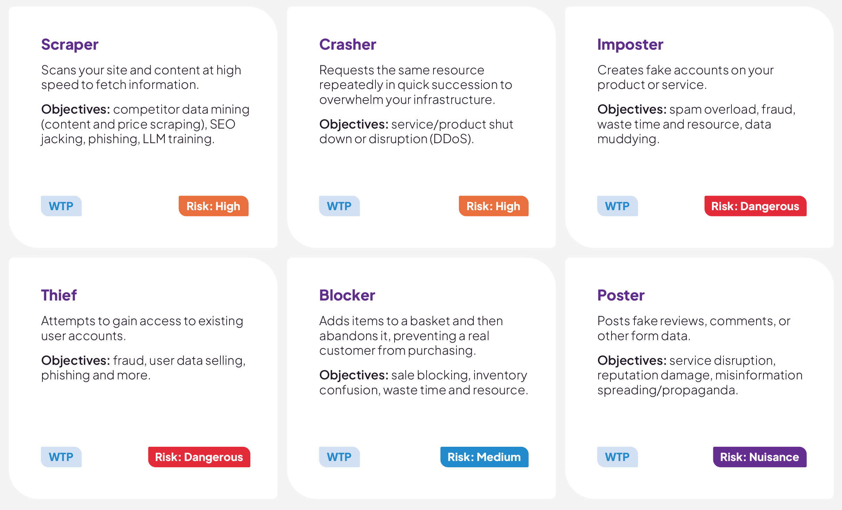
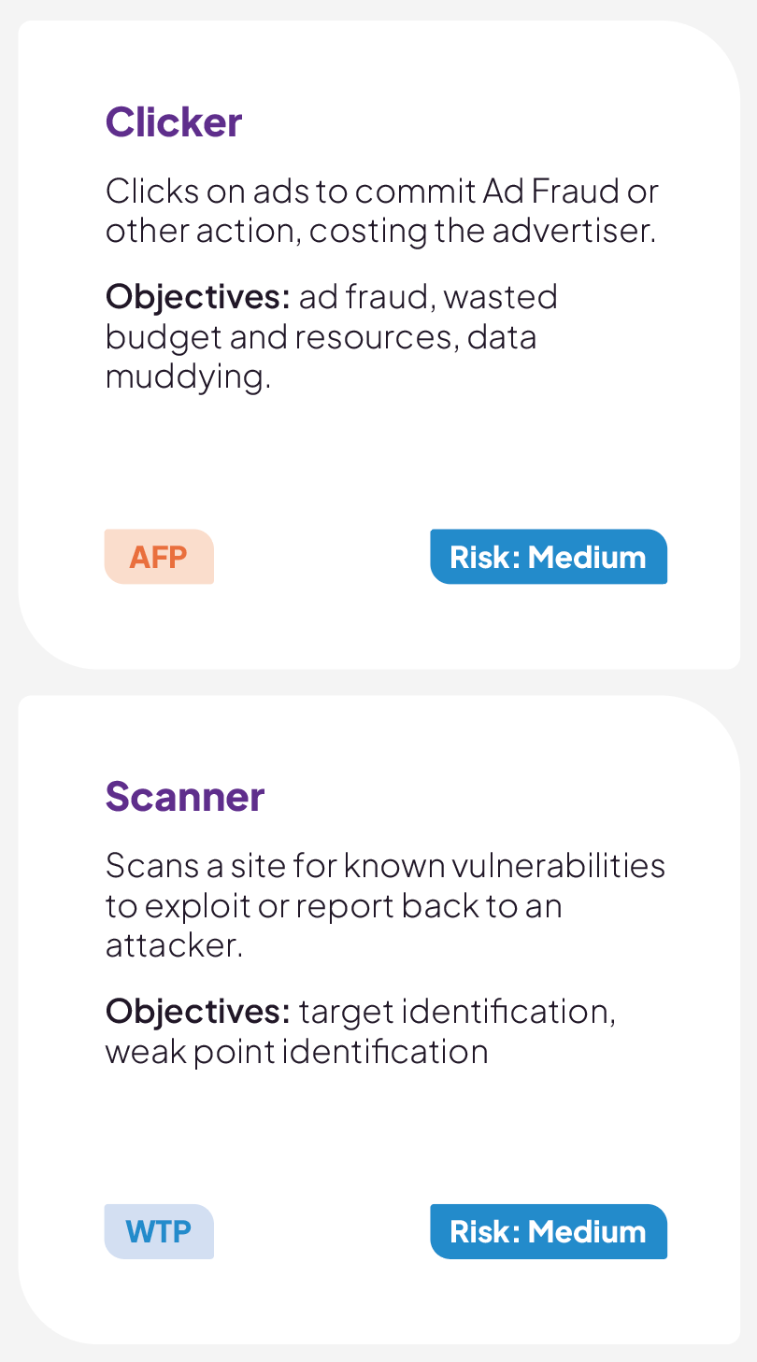
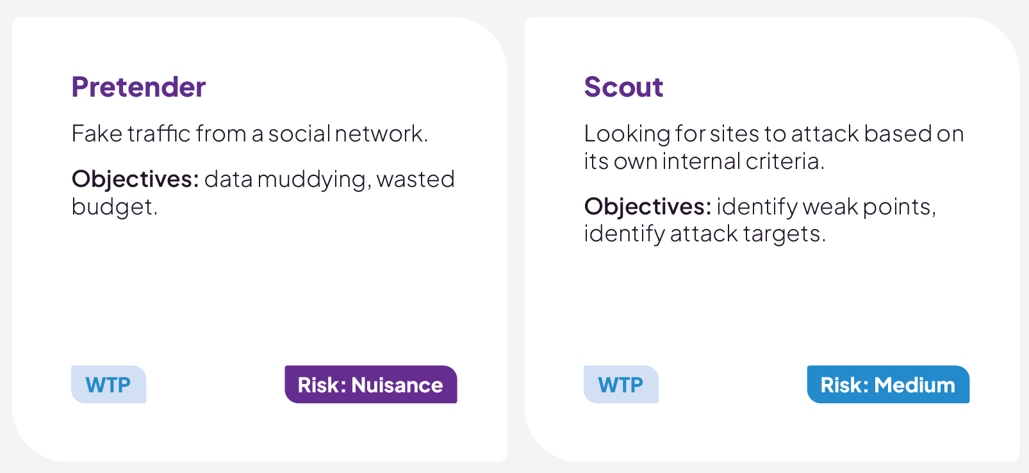
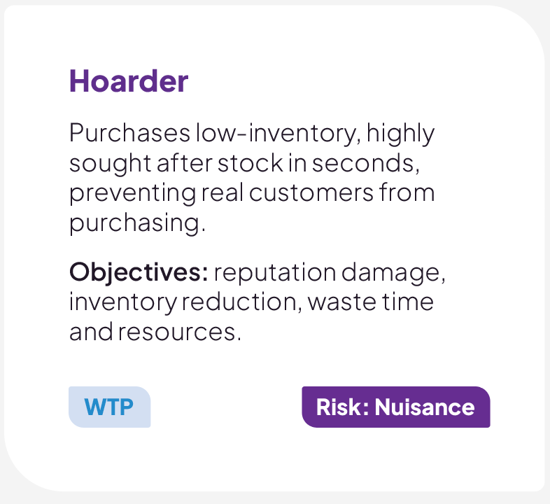
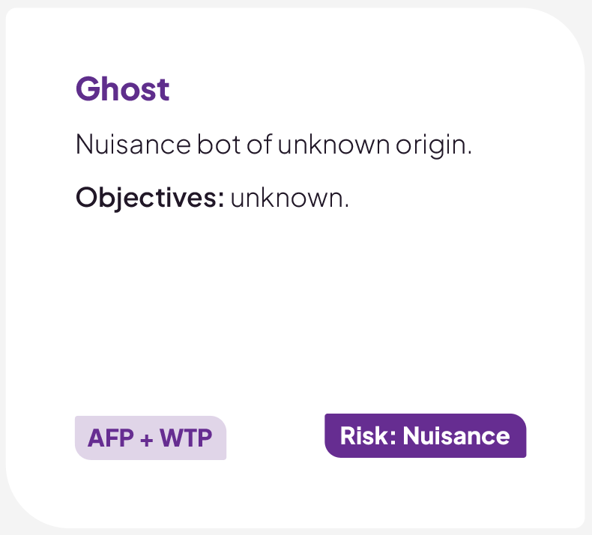
What are malicious bots doing?
Malicious bots can be classified into 12 types based on what objective they are designed to accomplish.
These range in risk level from nuisance through to dangerous. And objectives from phishing and DDoS attacks to data theft and wasted budgets.

Slide 14
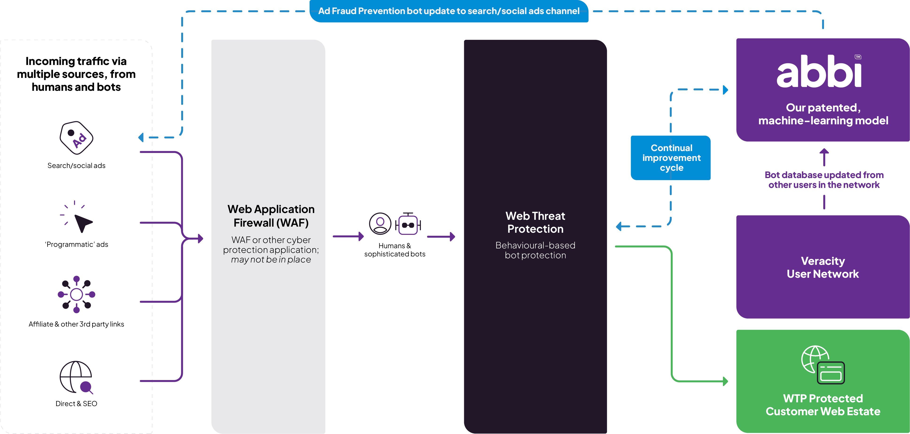
How Veracity Works

Slide 15
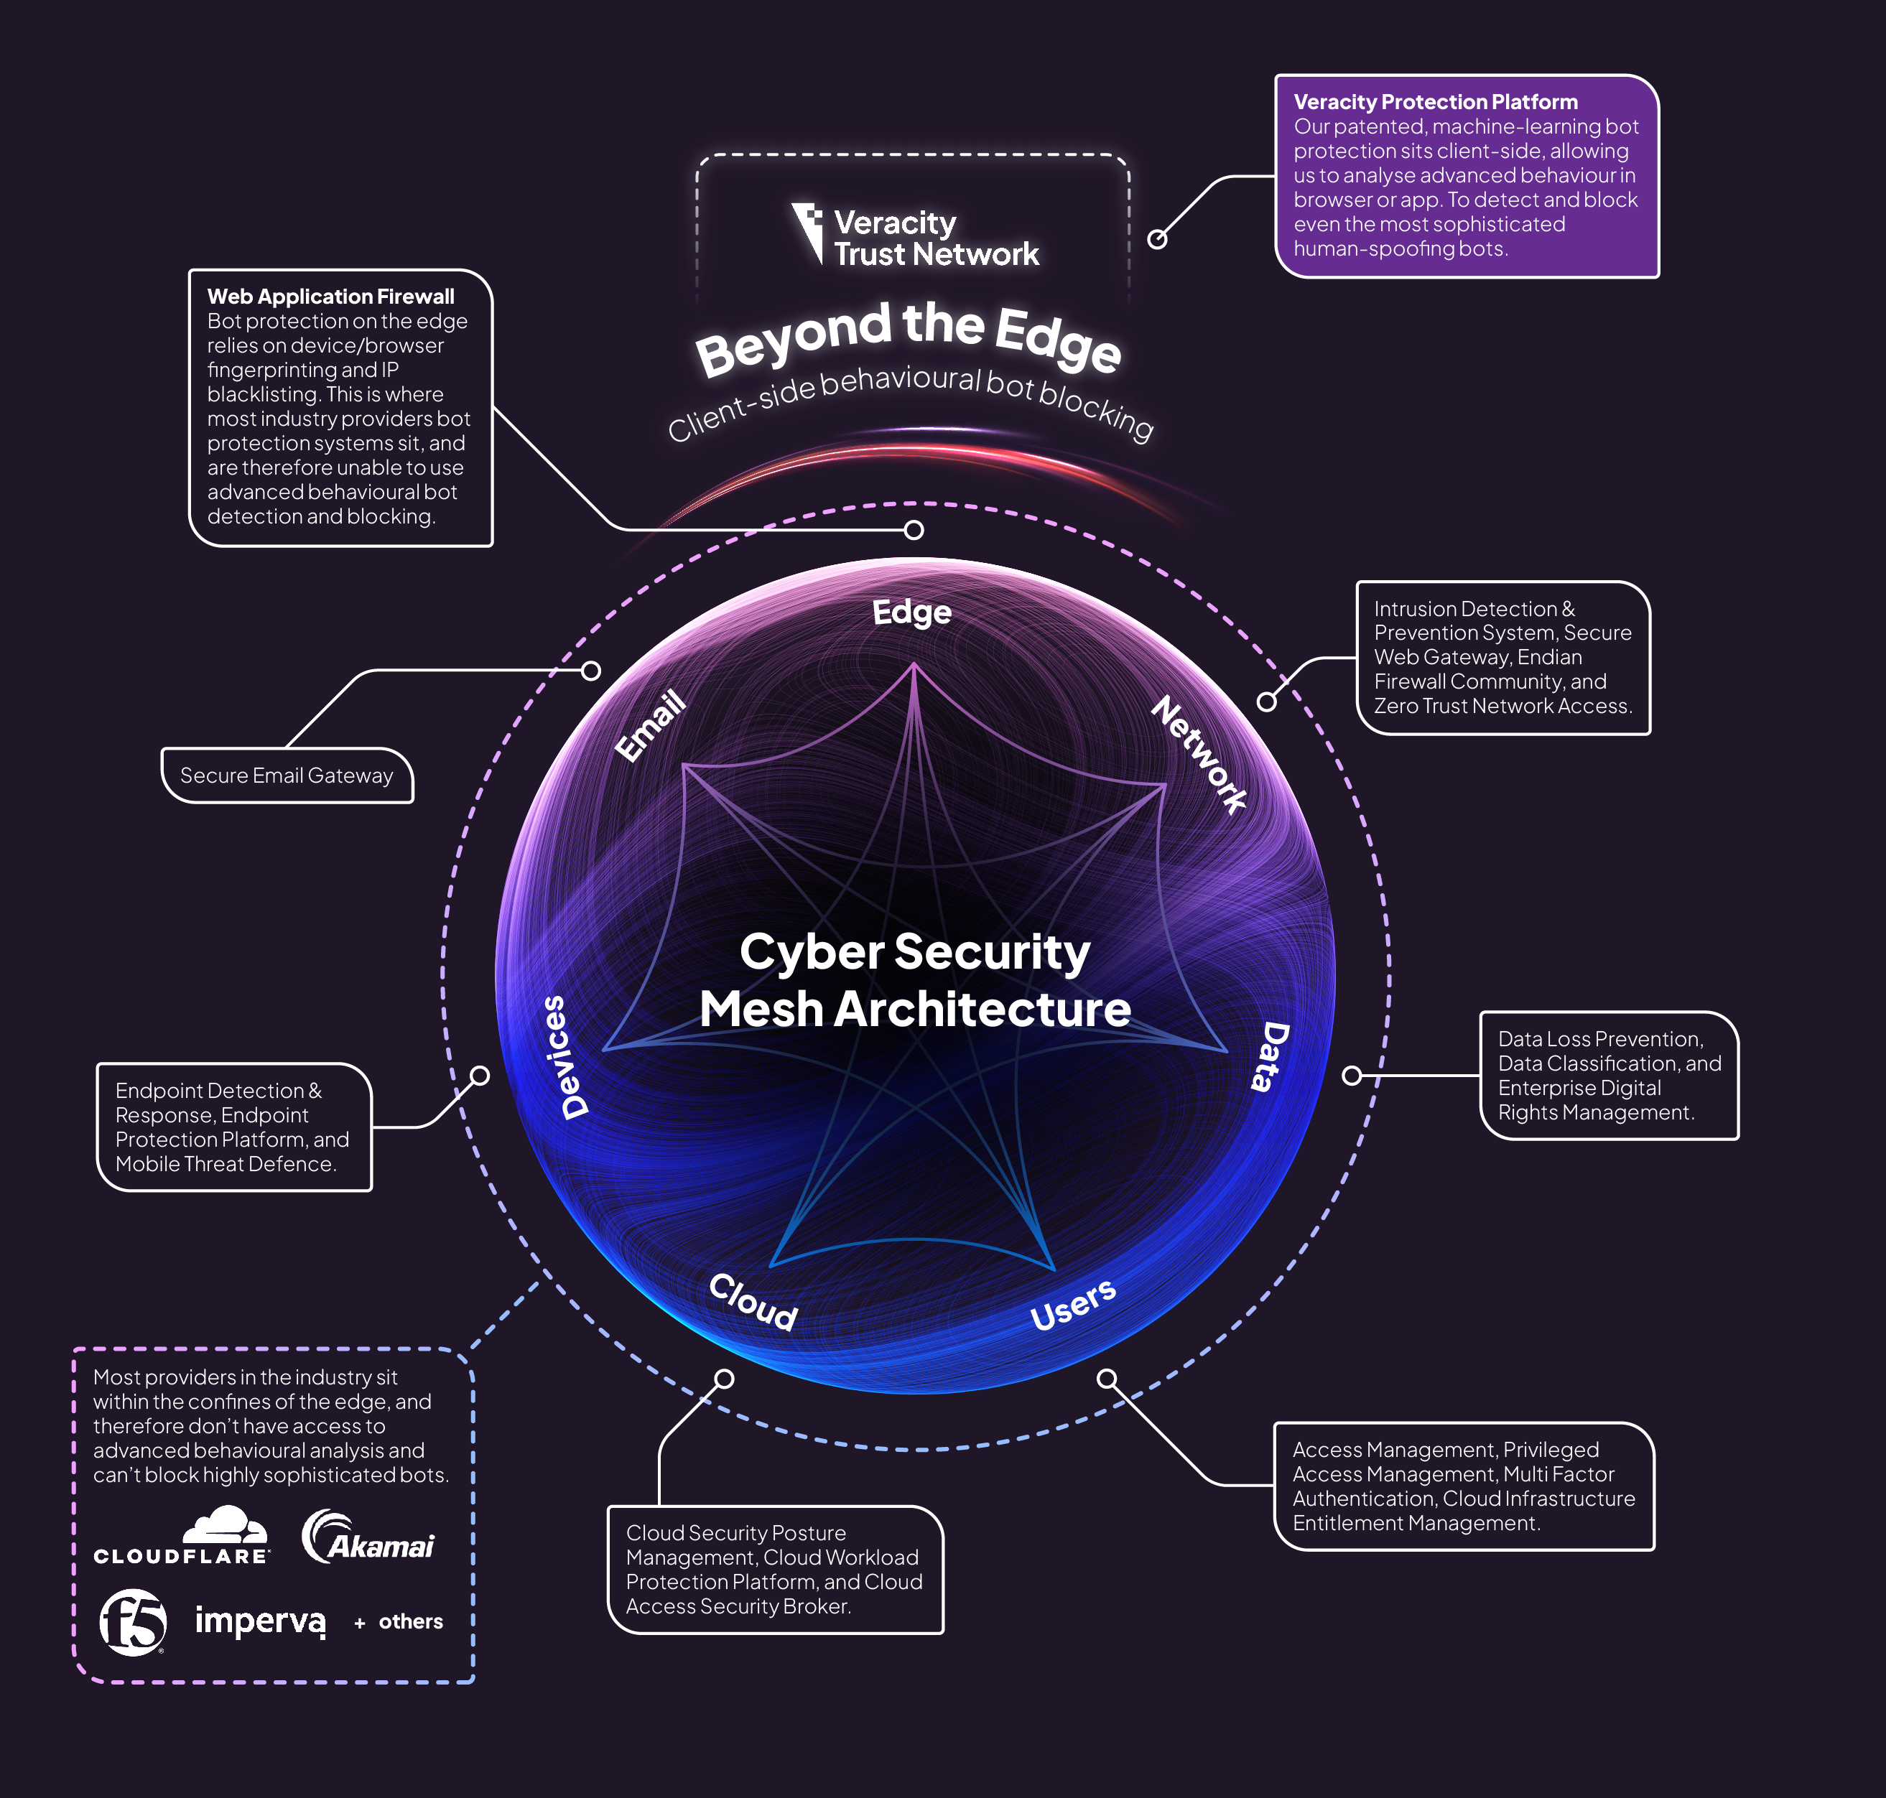
Security Mesh Position
While most providers in the industry sit in the edge to block bots using more traditional methods, we sit client-side – Beyond the Edge.
This allows us to use advanced behavioural-analysis, directly in browser or app, to block even the most sophisticated human-spoofing bots.
Diagram based on Gartner’s Cybersecurity Mesh from the Executive Guide to Cybersecurity Mesh, 2022

Slide 16

Product Benefits
Tomorrow’s protection, today
Our patent pending, machine-learning protection goes beyond basic behaviours to block even the most complex AI threats. And evolves just as quickly as they do.
Superfast and supersmart
Our revolutionary behaviour-based protection blocks human-spoofing bots before you can say data theft.
Effortless integration
Combines seamlessly with your existing security stack, and DDoS & WAF solutions, to block the ones they let through.
We block what others don’t
Our patent pending, machine-learning model – Abbi – thinks differently. Going beyond basic behaviours to block even the most complex AI threats.
<0.01% false positives
Block bots not humans with an incident rate of less than 0.01%. Any higher and we wouldn’t be doing our jobs.
Website. WebApp. Wi-Fi Fridge.
With just one line of JavaScript you can protect all your products. Better yet, see all your platforms in one simple dash.

Slide 17

Planet protection included
Try our CO² calculator
Malicious bots use energy just like we do. Cut your carbon with adaptive protection that works for you, and Mother Nature.
Example savings
If your average monthly sessions are:
80,000
Estimated monthly malicious bots
Estimated CO² emissions saved
17,760
26.64kg
Equivalent to driving an average petrol-powered car for
Equivalent to charging a smartphone
57.8 miles
1,172 times

Slide 18
Pricing made for humans
Our pricing is simple, you only pay for the bots we block.
So if you have edge protection in place that blocks simple bots, you won’t pay for those twice if you add our protection to your posture.
And if you don’t have other bot protection, then we block simple and sophisticated bots with just one line of code on your website.
PRICING MADE FOR HUMANS
You only pay for the bots we block. Human sessions won’t cost you a penny, cent, or dirham.

Slide 19
Platform screenshots

Slide 20
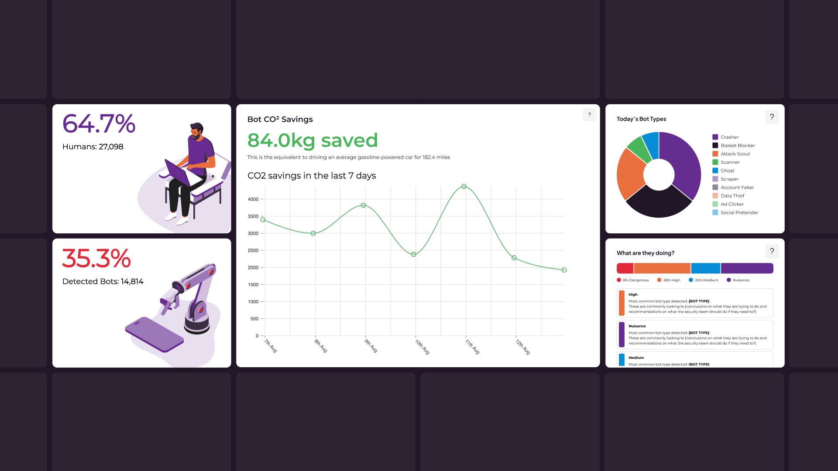
Web Threat Protection
Dashboard Examples

Slide 21
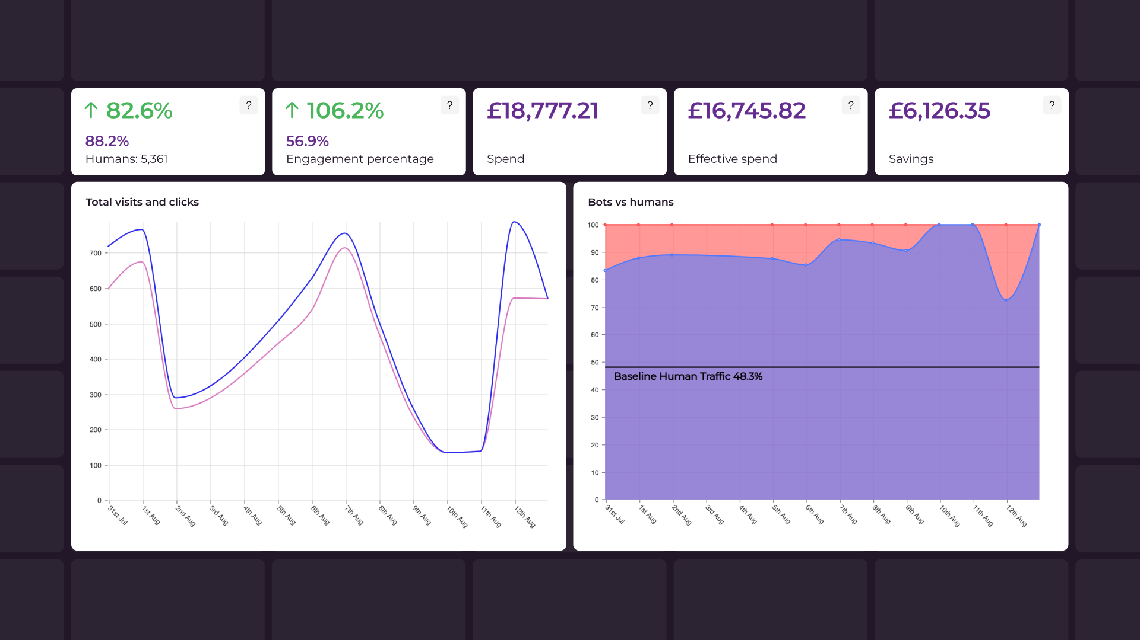
Ad Fraud Prevention Dashboard Examples

Slide 22
Benefits of blocking bots

Slide 23
Benefits of blocking bots in your ads
Wasting budget
Bot clicks will never convert, and are wasting your customers’ ad budgets
Reputational damage
Malicious bots could be scraping your data and pretending to be you, risking your reputation
Attack prevention
Your ads may be driving dangerous bots to your customers’ websites looking for targets for cyber crime
Competitor attacks
Your competitors could be buying bot traffic to waste your budgets and improve their rankings
Data accuracy
Reducing impressions and clicks from bots will decontaminate your data, allowing for accurate insights and improved strategies
Campaign effectiveness
Blocking bots from your ad campaigns will improve top of the funnel campaign effectiveness: more humans, less bots

Slide 24
Benefits of blocking bots on your website or app
Customer experience
Blocking bots saves your resources for humans, delivering a faster website and a smoother experience
Data accuracy
Removing fraudulent traffic gives you a clear view of your data, leading to better strategies and improved analytics
Reduce CO² emissions
Malicious bots use carbon just like human sessions do, by blocking the bots you reduce your infrastructure costs and emissions
Attack prevention
Blocking malicious bots protects you from data theft, account takeovers, phishing scams and more
Protect your reputation
Protecting yourself from the growing threat of malicious bots not only protects your bottom line but also protects your long-term reputation
Save time and resources
By implementing machine-learning bot protection you can free up your team’s time to focus on what matters most — growing your business

Slide 25
Customer comments

Slide 26

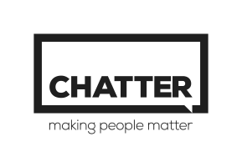
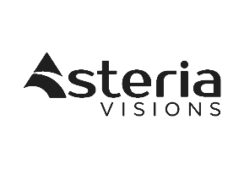



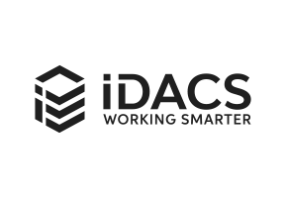
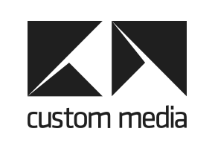
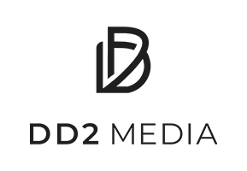
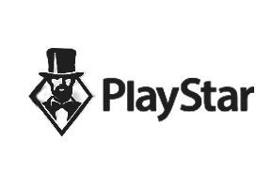

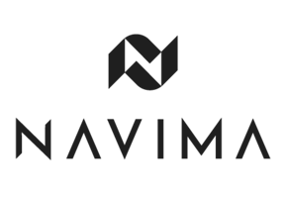
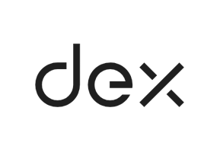
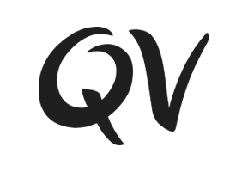

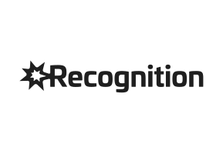
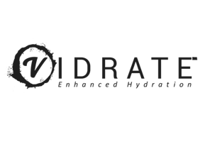
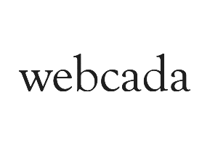
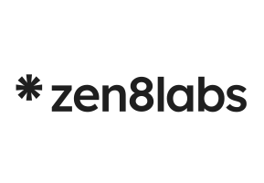

Clients
UK & Europe
Asia Pacific
United States

Slide 27

“
I was unaware of the extent of bot presence on our website and within our ad campaigns. Veracity was a real awakening to the issues. It highlighted, that even while using a Content Delivery Network (CDN) solution claiming bot detection capabilities, malicious bot activity was still a substantial concern in terms of wasted budget and cyber risk.
Head of Marketing, Caspian Insurance — Registered Insurance Customer

Slide 28

“
Cyberattacks keep my investors awake at night. We might be behind in sales or cash is tight, but these things are fixable. Whereas a cyberattack is utterly deadly. You need to be prepared and have the right kit. So, with Veracity’s Protection Platform in place we feel much more secure.
Chief Commercial Officer, Navima — Financial Sector Customer

Slide 29
Any questions?
www.veracitytrustnetwork.com

