Slide 1
Partner Onboarding
www.veracitytrustnetwork.com

Slide 2
Who We Are

Slide 3
Malicious bots are constantly evolving, and so are we. Our patent pending, machine-learning bot protection lives on your digital estate, analysing micro-behaviours, to identify and block threats in real-time. Put simply — we block what others don’t.
Our Mission

Slide 4
Sales Stack
Global presence
We’re headquartered in the UK, with a subsidiary company in Singapore. We’re also highly active in the UK, Asia Pacific, and the GCC. With clients in the US & EU as well.
Advanced behavioural protection
Our patent pending, machine-learning protection goes beyond basic behaviours to block even the most complex AI threats.
Bot threats we stop
Data theft. Fake account creation. Data scraping. Account takeovers. Attack scouting. Basket blocking. Data contamination. Ad abuse. Budget waste.
What we protect
Abbi (our machine-learning model) protects digital ads (Ad Fraud Prevention) and websites or web apps (Web Threat Protection) from sophisticated bots.
Our Audience
Organisations vulnerable to the growing threat of sophisticated malicious bots on their website and looking to protect their ad budget from fraudulent bot clicks.
Why we’re different
We’re the only bot defence platform that sits Beyond the Edge to utilise real-time behavioural analysis to detect and block even the most complex bots.

Slide 5
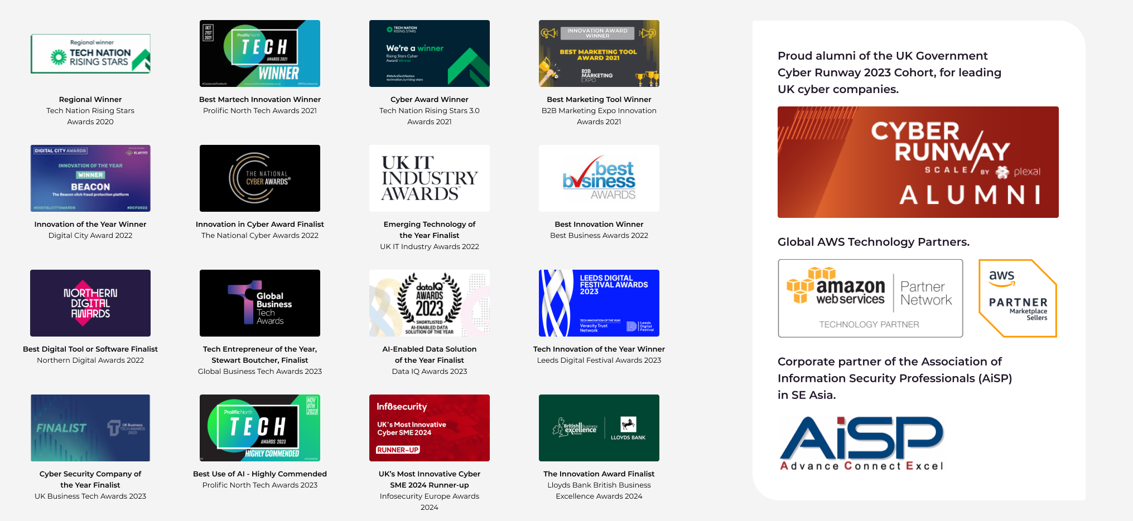
Award-winning protection

Slide 6

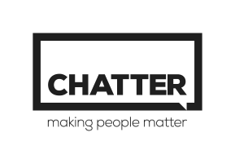


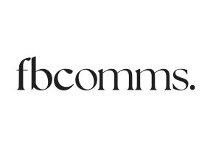

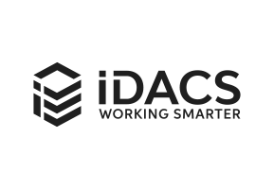
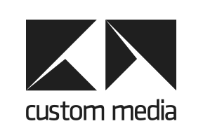
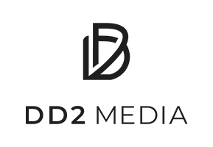
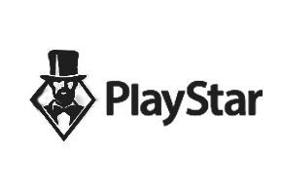
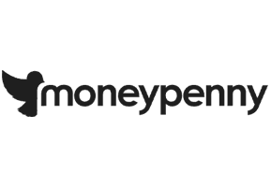
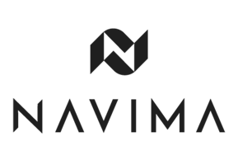
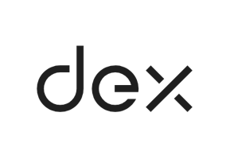
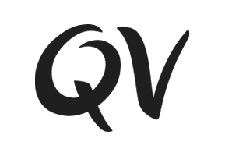

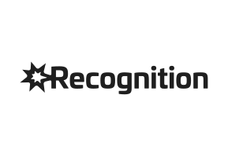

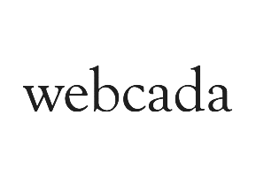
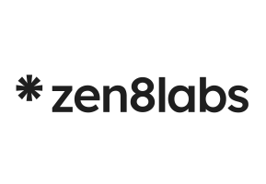

Clients
UK & Europe
Asia Pacific
United States

Slide 7
The Bot Problem

Slide 8
The scale of the problem
30%
of all traffic to websites is from sophisticated malicious bots
$4.45m
the global average cost of a data breach*
11%
of UK businesses and 8% of charities experienced cybercrime in the last 12 months**
~50%
Of consumers said they had stopped doing business with a company known to have experienced data loss through cybercrime***
*Ponemon Institute survey on behalf of IBM. **UK Cyber security breaches survey 2023. ***IBM Report — the Cost of Data Breaches

Slide 9
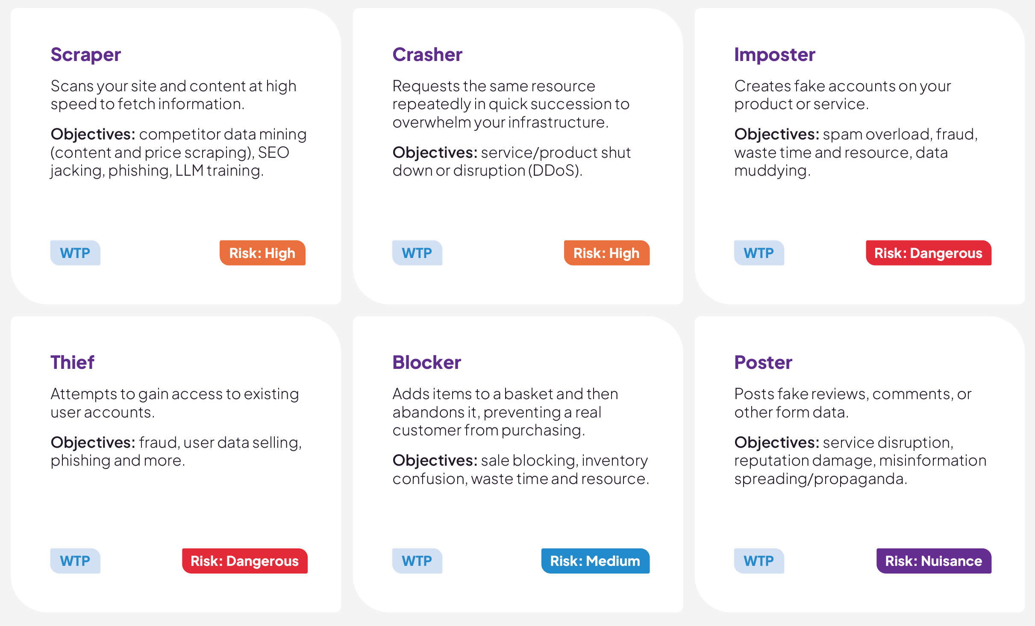
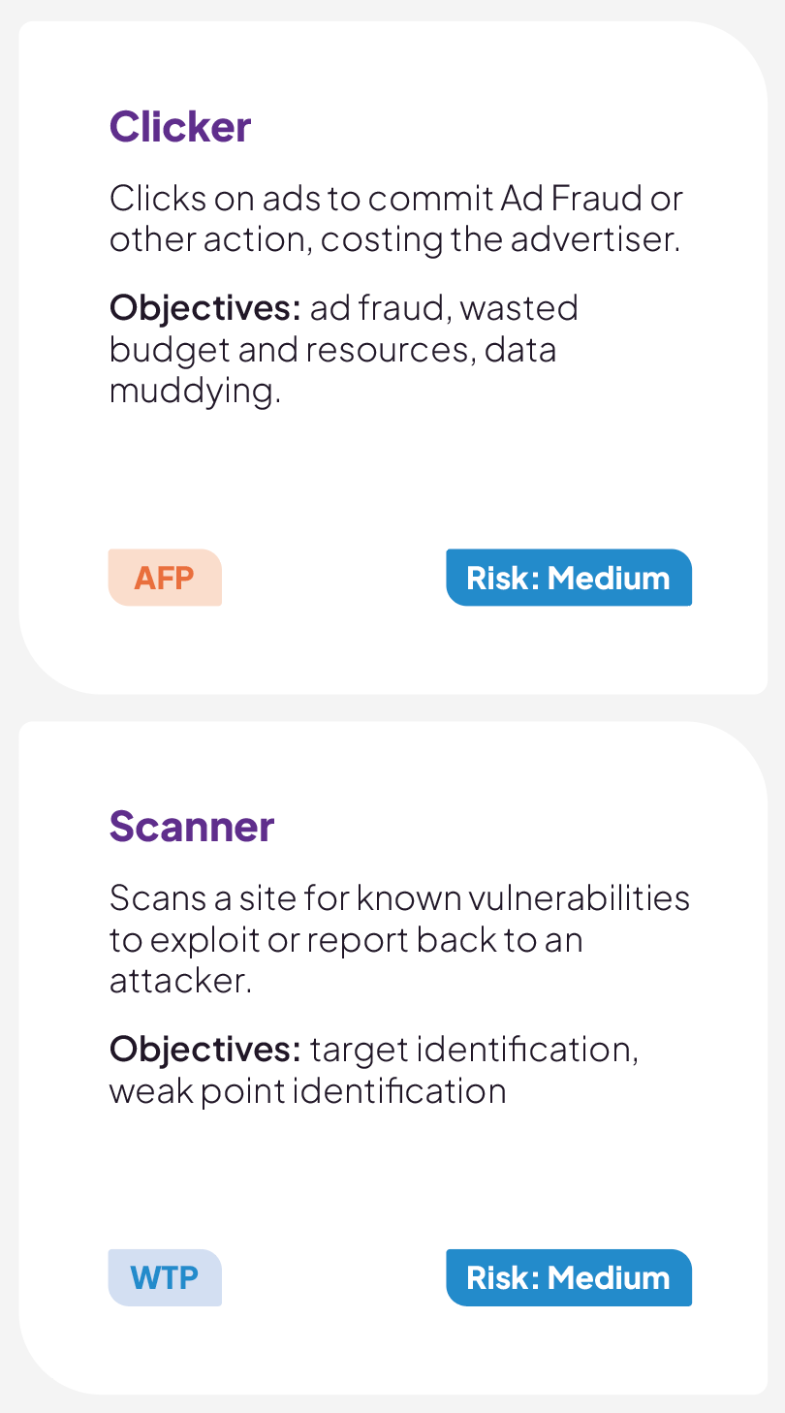
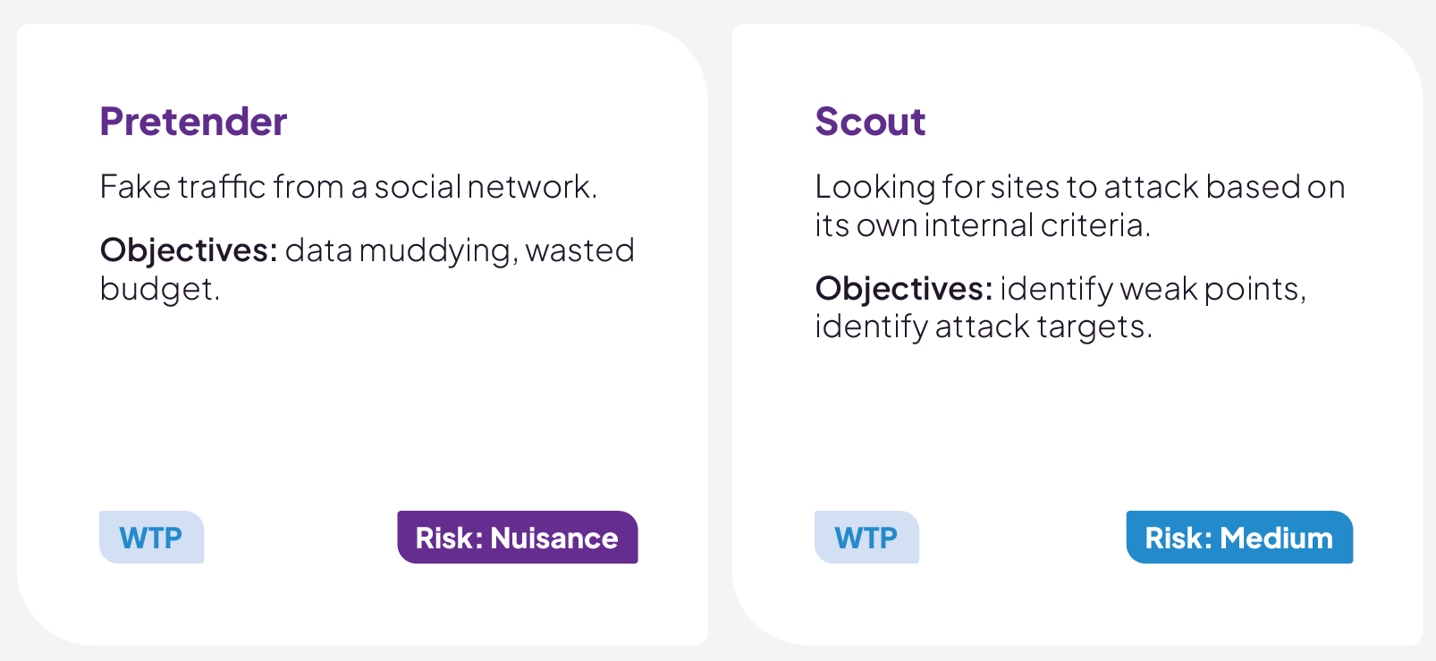
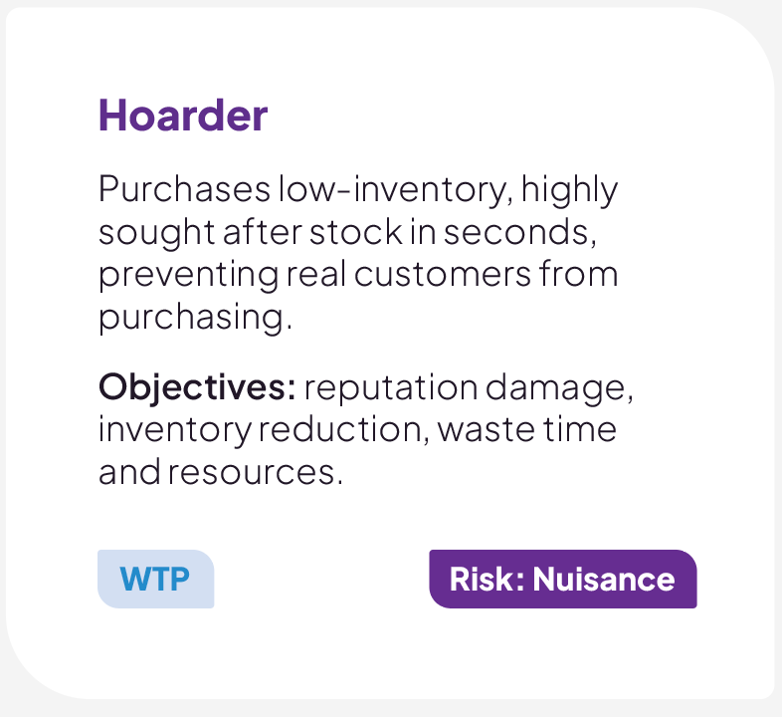
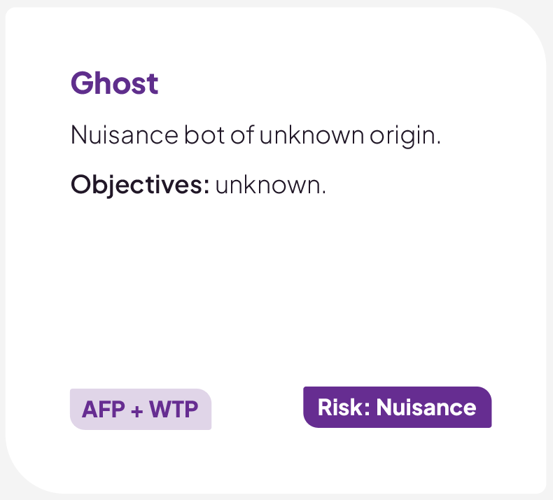
What are malicious bots doing?
Malicious bots can be classified into 12 types based on what objective they are designed to accomplish.
These range in risk level from nuisance through to dangerous. And objectives from phishing and DDoS attacks to data theft and wasted budgets.

Slide 10
Industry Breakdown
Automotive
Price scraping, data scraping, inventory checking
Business Services
Attacks on the API layer, data scraping, account takeover
Education
Account takeover for students & course availability, scraping research & data
Entertainment & Arts
Account takeover, price scraping, inventory checking, scalping
Financial Services
Account takeover, card cracking, content scraping
Food & Beverage
Credit card fraud, gift card fraud, account takeover
Gaming & Gambling
Account takeover, odds scraping, account creation for promotion abuse
Government & Public Services
Account takeover, data scraping of business & voter information
Healthcare Services
Account takeover, content scraping, inventory checking, appointments/availability
Information Tech
Account takeover, scraping
Marketing & Agencies
Custom content scraping, ad fraud, denial of service
News & Media
Custom content scraping, ad fraud, comment spam, fake accounts
Retail & eCommerce
Denial of inventory, credit card fraud, gift card fraud, account takeover, data and price scraping
Sports
Sports updates, news, live score services data scraping (live scores, odds, etc)
Telco
Account takeover, competitive price scraping
Travel & Airlines
Price & data scraping, skewing of look-to-book ratio, denial of service, price scraping, account takeover

Slide 11
The Veracity
Protection Platform

Slide 12
The Veracity Protection Platform
The Veracity Protection Platform defends your digital ads and products from sophisticated bots.
Our modular platform includes Ad Fraud Prevent (for organisations running ads) and Web Threat Protection (for organisations with a website, web app, or mobile app). Both products are powered by Abbi, and benefit from the same machine-learning, behavioural analysis to detect and block bots.
And better still, both products are visible in one dashboard, so all the data is at your fingertips.
Veracity Protection Platform
Digital Product Protection
Web Threat
Digital Advertising Protection
Ad Fraud
Problems WTP solves:
Data Theft
Fake Accounts
Data Scraping
Account Takeovers
Attack Scouting
Basket Blocking
Problems both solve:
Data Contamination
+ more
Problems AFP solves:
Ad Abuse
Budget Waste
+ more

Slide 13


Ad Fraud Prevention
Block bot clicks and cut digital ad budget waste by up to 66%.
For organisations running digital ads
Bot detection solutions that protect your online advertising from automated attacks. Ad Fraud protection safeguards your marketing budget, empowers marketers to accurately measure results, and reduces ad budget waste by up to 66% for brands and agencies.
Web Threat Protection
Stop malicious bot attacks against your websites — or your clients’.
For organisations with a website or webapp
Bot detection solutions that protect your websites from automated attacks. Safeguarding your online revenue, competitive edge, and brand reputation by addressing security and fraud challenges to minimise vulnerabilities, prevent loss, and ensure an efficient customer experience.

Slide 14


Introducing abbi
abbi (adaptive bot blocking intelligence), our patent pending, machine-learning model, thinks differently. Going beyond basic behaviours to block even the most complex AI threats.

Slide 15
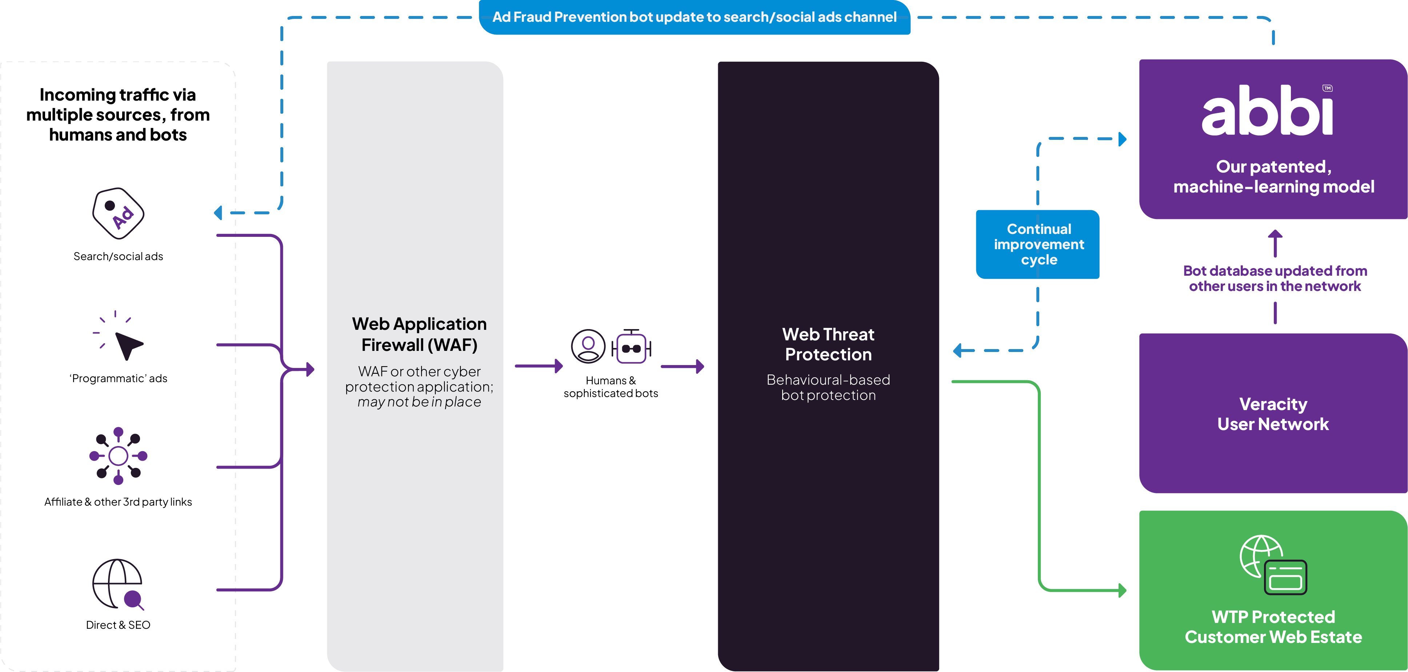
How Veracity Works

Slide 16
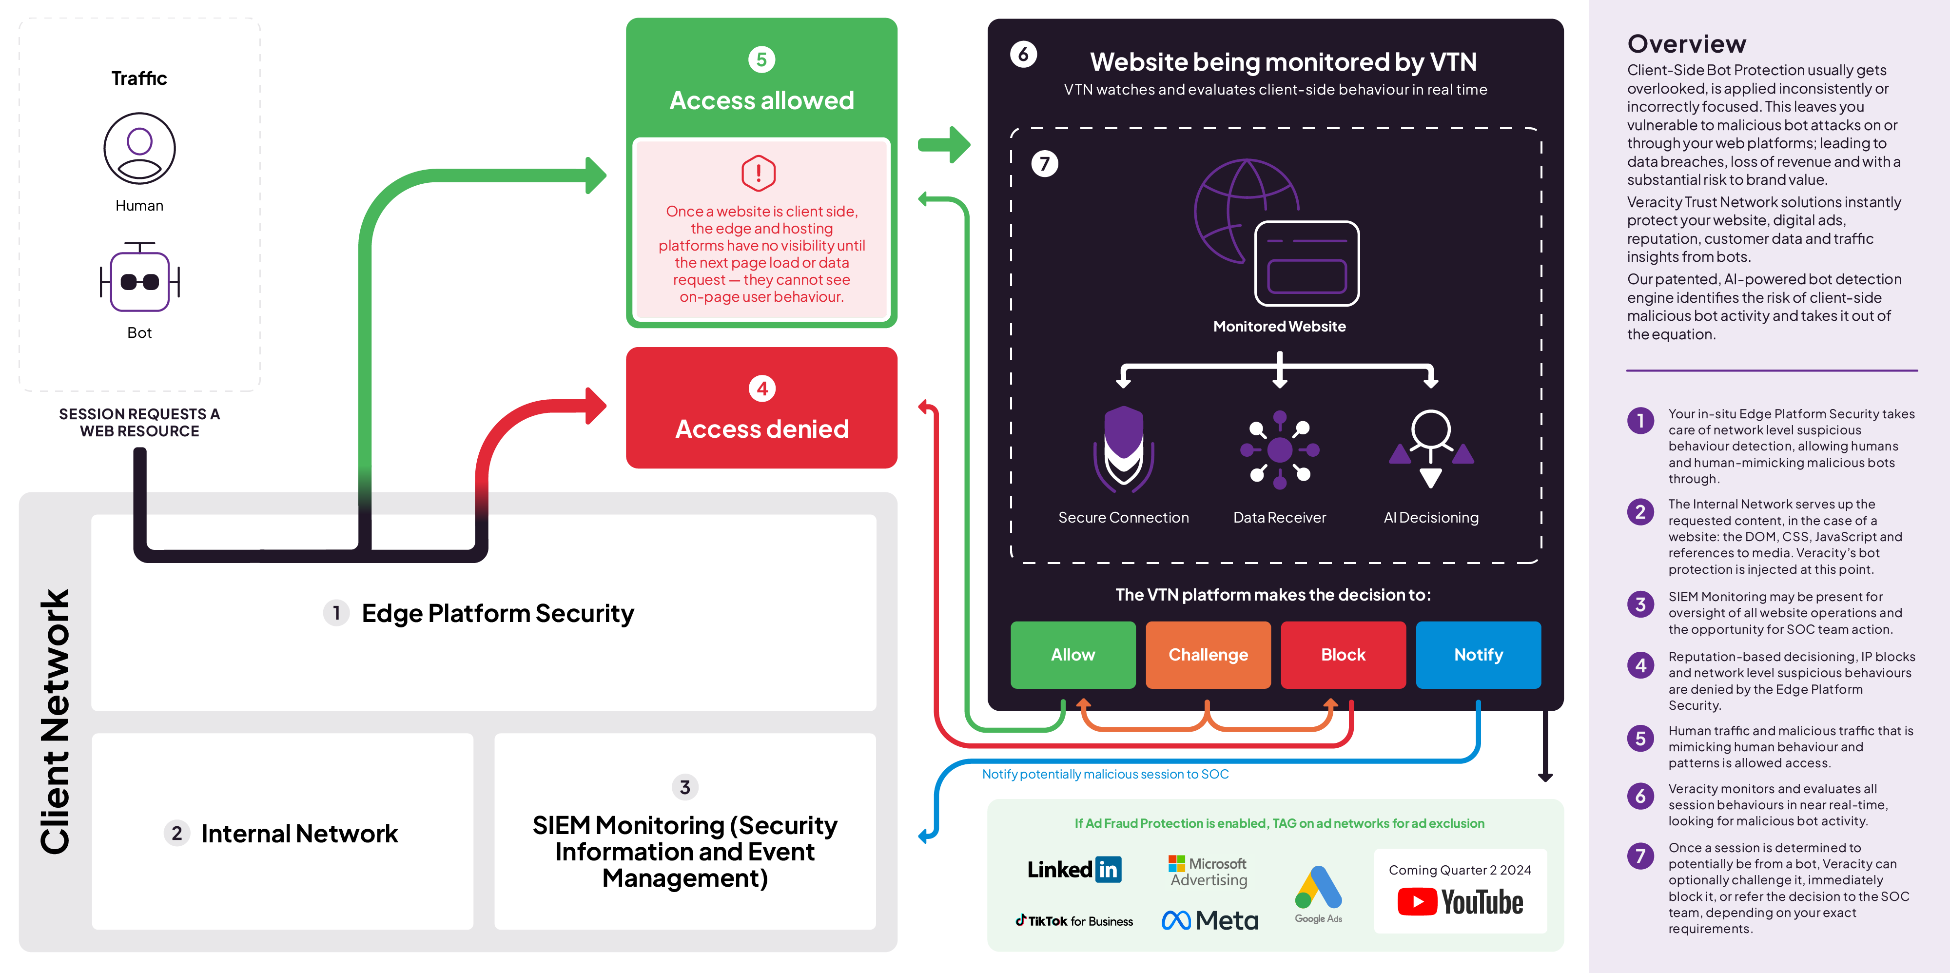
Client-side bot protection: reference architecture

Slide 17
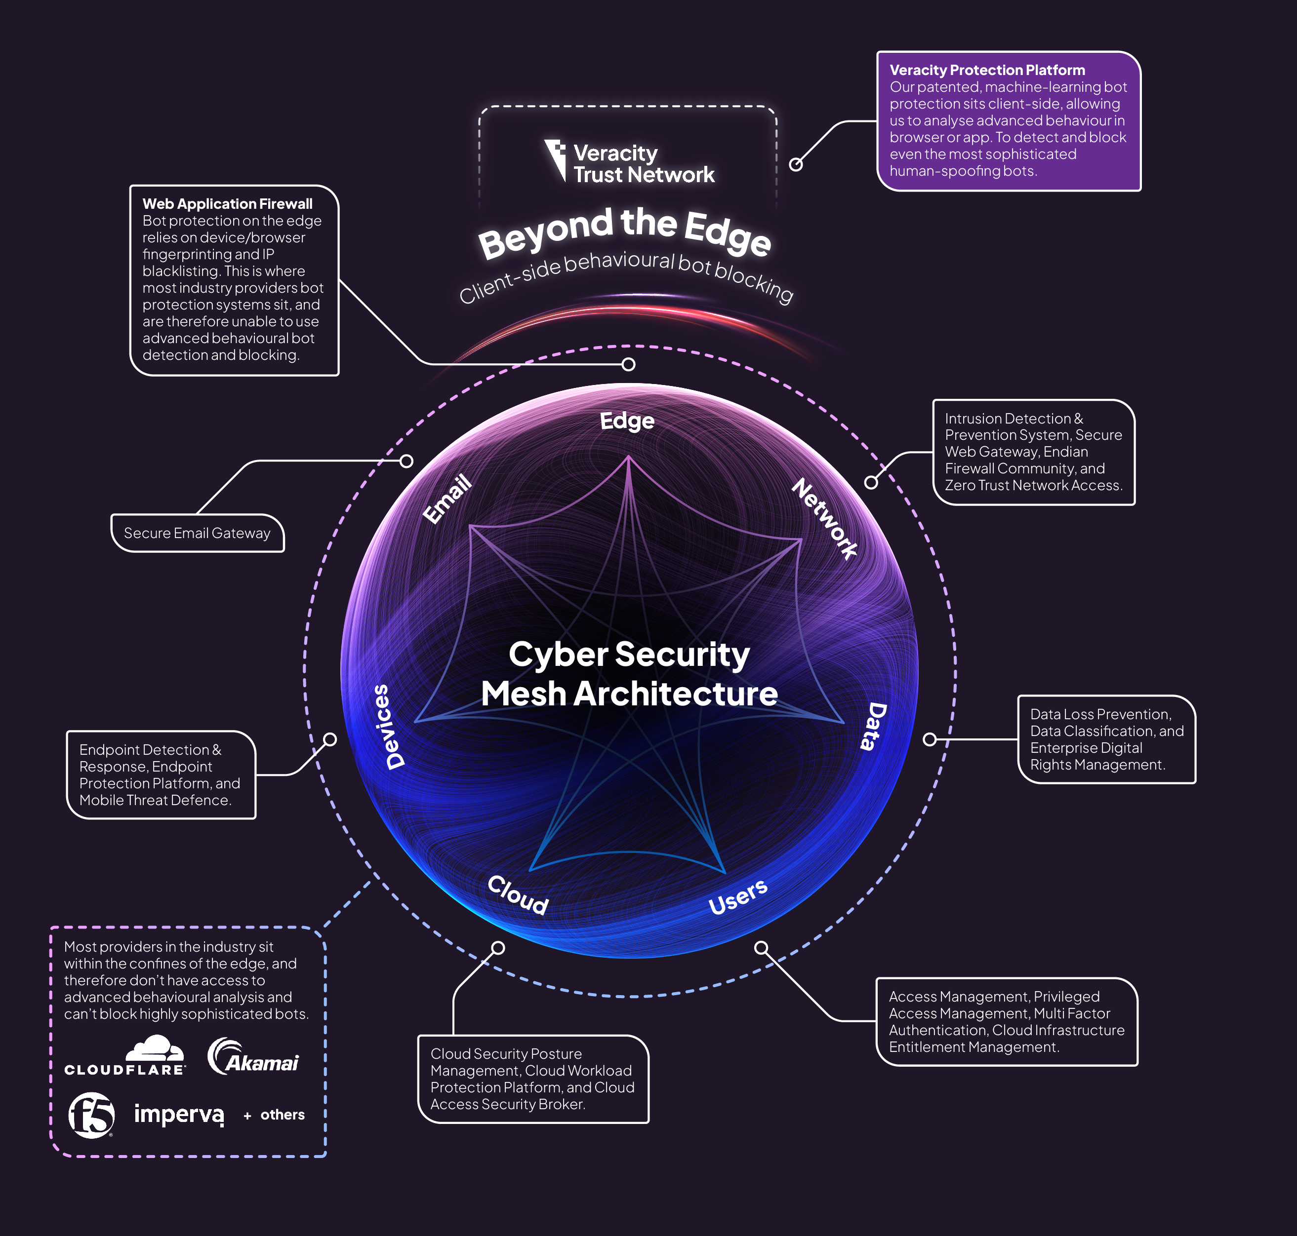
Security Mesh Position
While most providers in the industry sit in the edge to block bots using more traditional methods, we sit client-side – Beyond the Edge.
This allows us to use advanced behavioural-analysis, directly in browser or app, to block even the most sophisticated human-spoofing bots.

Slide 18

Product Benefits
Tomorrow’s protection, today
Our patent pending, machine-learning protection goes beyond basic behaviours to block even the most complex AI threats. And evolves just as quickly as they do.
Superfast and supersmart
Our revolutionary behaviour-based protection blocks human-spoofing bots before you can say data theft.
Effortless integration
Combines seamlessly with your existing security stack, and DDoS & WAF solutions, to block the ones they let through.
We block what others don’t
Our patent pending, machine-learning model – Abbi – thinks differently. Going beyond basic behaviours to block even the most complex AI threats.
<0.01% false positives
Block bots not humans with an incident rate of less than 0.01%. Any higher and we wouldn’t be doing our jobs.
Website. WebApp. Wi-Fi Fridge.
With just one line of JavaScript you can protect all your products. Better yet, see all your platforms in one simple dash.

Slide 19

Planet protection included
Try our CO² calculator
Malicious bots use energy just like we do. Cut your carbon with adaptive protection that works for you, and Mother Nature.
Example savings
If your average monthly sessions are:
80,000
Estimated monthly malicious bots
Estimated CO² emissions saved
17,760
26.64kg
Equivalent to driving an average petrol-powered car for
Equivalent to charging a smartphone
57.8 miles
1,172 times

Slide 20
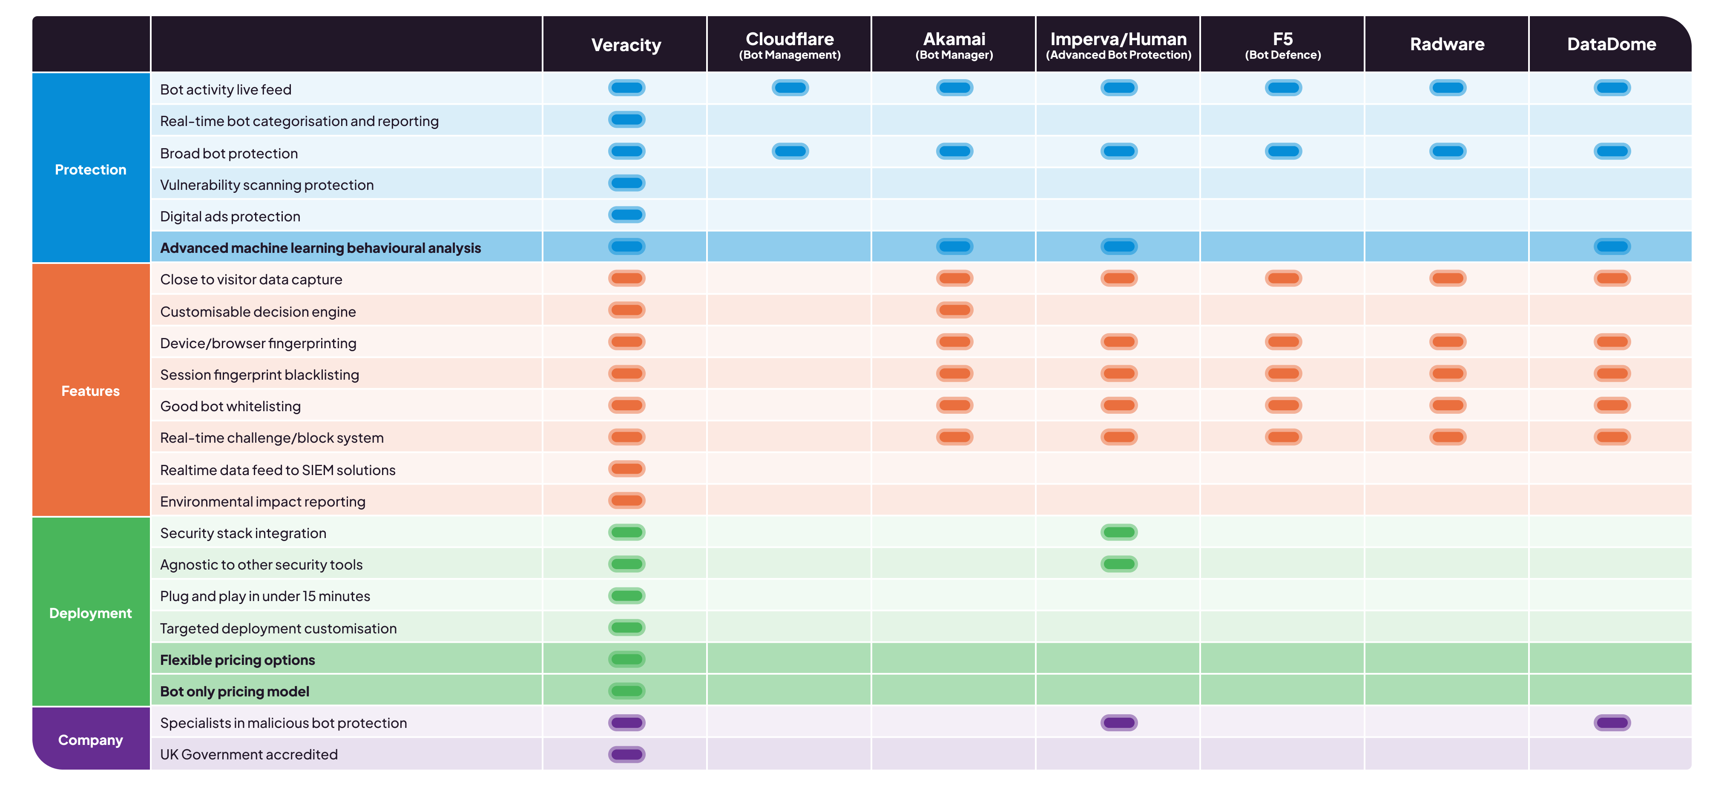
The Web Threat Protection Market

Slide 21
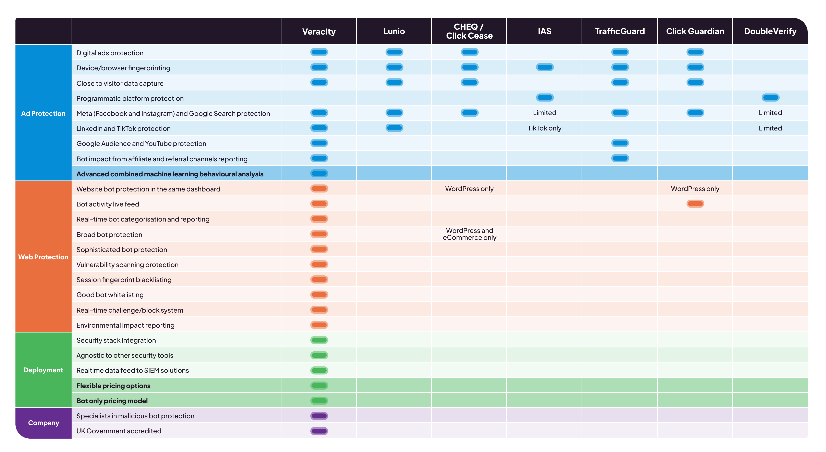
The Ad Fraud Prevention Market

Slide 22
Commercials

Slide 23
Pricing made for humans
A bot-only pricing model (where the customer only pays for the bots we block) shows our confidence in our bot-blocking model. And allows us to shout about it as a core differentiator.
This also allows us to sell to customers who already have edge solutions in place e.g. Cloudflare, as we block bots that they can’t. And the customer only pays for those rather than all sessions analysed.
PRICING MADE FOR HUMANS
You only pay for the bots we block. Human sessions won’t cost you a penny, cent, or dirham.

Slide 24
Approach to licence
Step 1
Free, no-obligation, limited traffic two-week “audit” to show them the volume of bots, bot types, and the risk they pose.
Step 2A
3 month “proof of concept” at a capped price. Detecting and blocking bots.
Step 3
12/24 month licence on an appropriate discounted commercial model.
Step 2B
Rolling monthly contract.

Slide 25
Potential commercial models
*example pricing only
Option 1
Pay a fixed price per bot detected & blocked.
Option 2
Pre-purchase a number of blocks and top-up when they are all used.
Option 3
Purchase a set number of bots/month for a longer term, with 5% overage allowance included. Carry forward 15% of unused blocks to next month.
Example – the audit suggests 20% bots on 100k monthly sessions. Customer purchases 20k blocks/month at $0.25/block. This allows overage of 1,000/month. And 3,000/month to be carried forward if unused.
Example – pay a small monthly platform fee of $500 up-front, and then pay $0.45 per bot blocked in arrears (less the $500 deposit).
Example – pre-purchase 10,000 blocks at $0.35 per block; use them until they are all used.

Slide 26
Any questions?
nick.pomeroy@vtn.live

